Slide 1
Digital Portfolio
STUDENT NAME: Akash. D
REGISTER NO AND NMID: 24132251802521003
DEPARTMENT: B, Sc. Computer science
COLLEGE: Government arts scienceCOLLEGE/ annamali UNIVERSITY

Slide 2
PROJECT TITLE
Student Digital
Portfolio
1. Project Title
· A clear and concise name that reflects the
project.
*"Smart Attendance System using
Face Recognition)

Slide 3


AGENDA
Problem Statement
Project Overview
End Users
Tools and Technologies
Portfolio design and Layout
Features and Functionality
Results and Screenshots
Conclusion
Github Link
3/21/2024 Annual Review

Slide 4

PROBLEM STATEMENT
Define the main issue or challenge the project addresses. Why is this problem important? * Manual attendance systems are time-consuming and prone to errors.)

Slide 5

PROJECT OVERVIEW
Brief summary of the project.Objectives and goals.
Scope of the project.
· * This project automates
attendance by integrating Al-based face recognition for accuracy and efficiency.

Slide 6

WHO ARE THE END USERS?
Who will use this project?* oStudents Teachers o Educational institutions

Slide 7

TOOLS AND TECHNIQUES
Mention software, programming languages, and technologies used.·* o Languages: Python, JavaScript o Frameworks: Django, React oDatabases:MySQL, Firebase oTools: VS Code, GitHub, Figma

Slide 8
POTFOLIO DESIGN AND LAYOUT
Describe how the digital portfolio is structured Visual design choices (colors, fonts, themes). • Navigation flow (homepage, about project, screenshots, results).
8

Slide 9
FEATURES AND FUNCTIONALITY
Describe how the digital portfolio is structured Visual design choices (colors, fonts, themes). • Navigation flow (homepage, about project, screenshots, results).

Slide 10
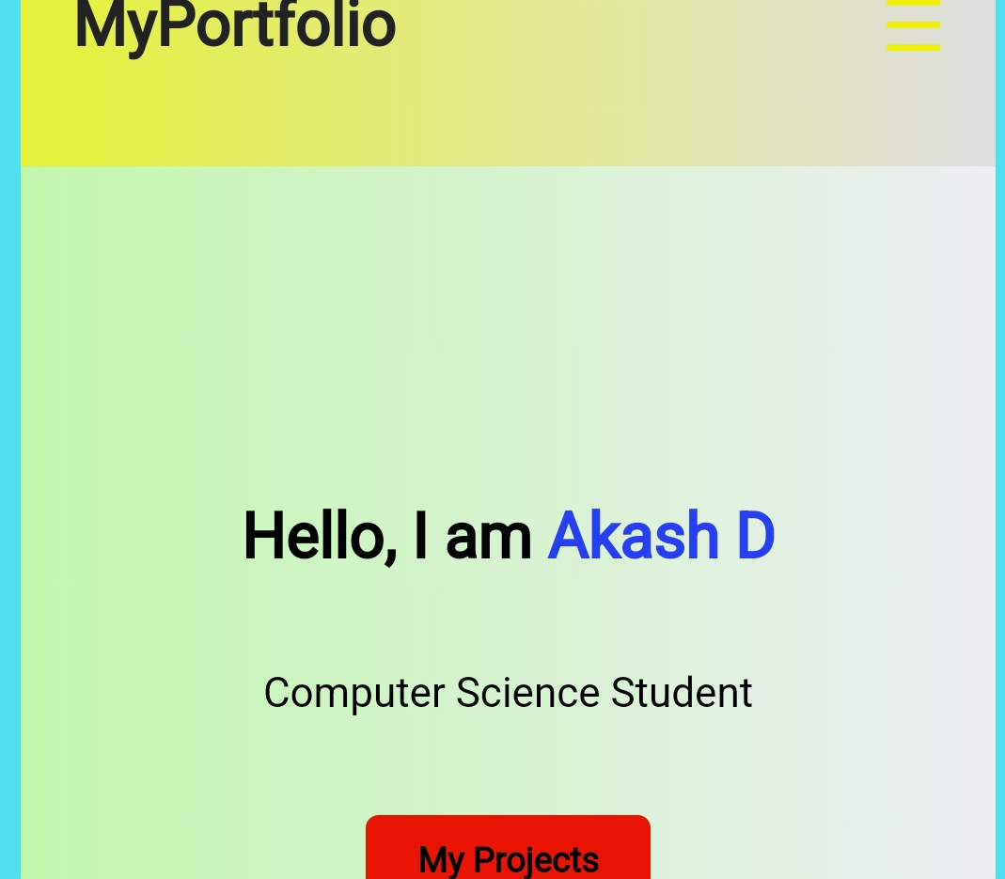
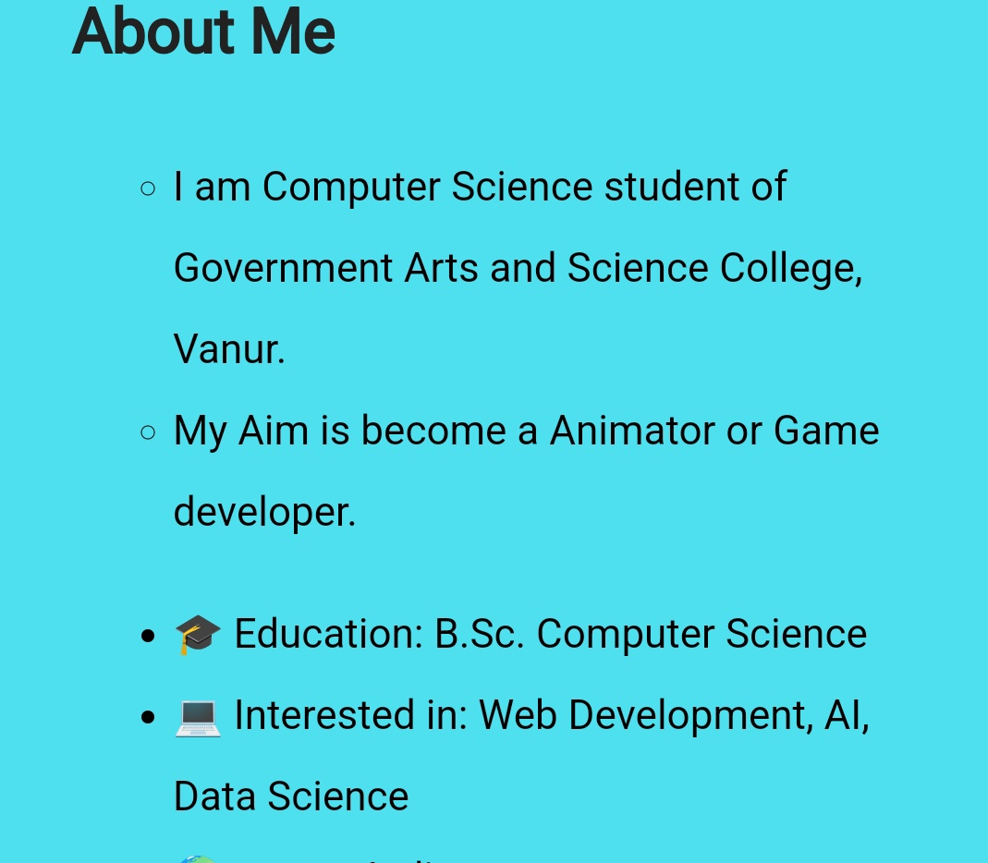

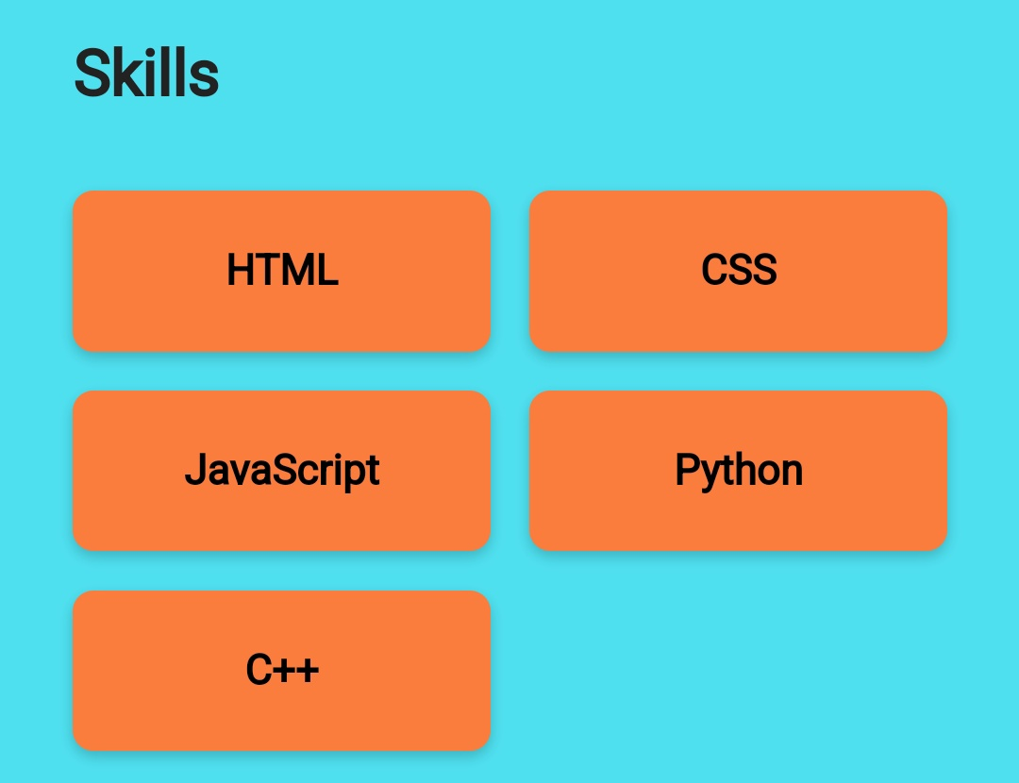
RESULTS AND SCREENSHOTS
3/21/2024 Annual Review
10

Slide 11
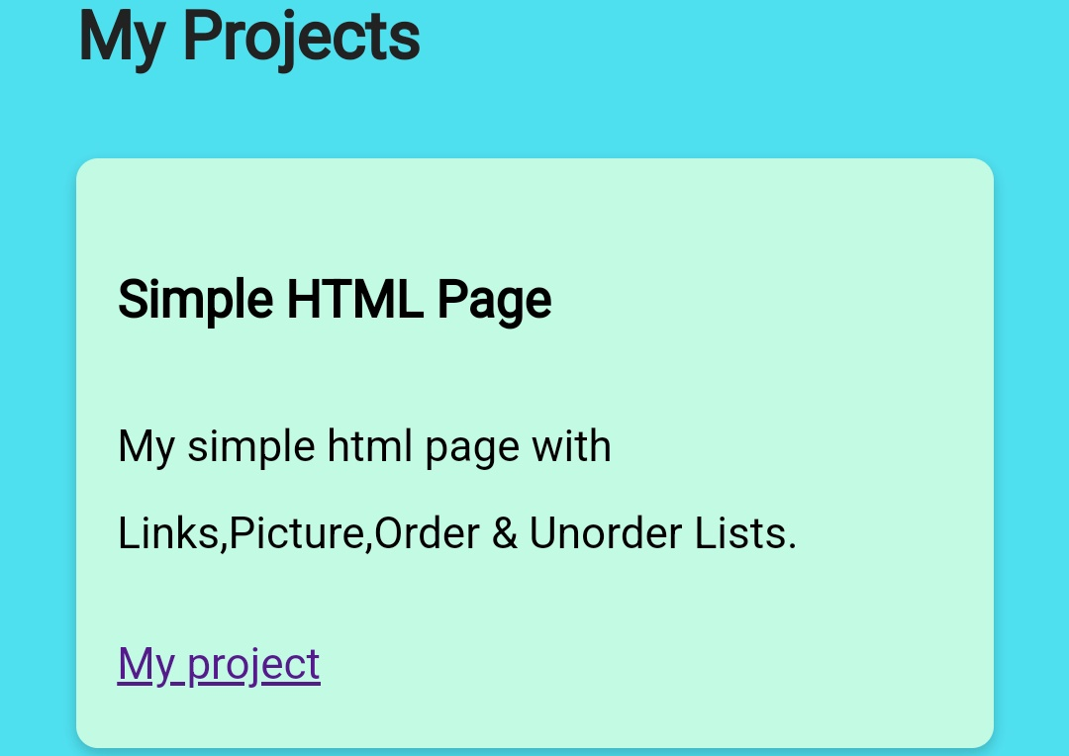
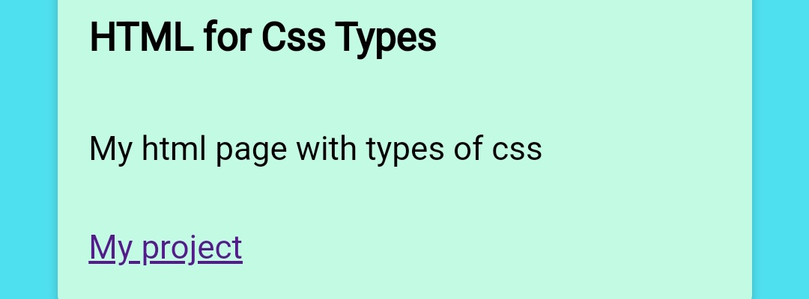
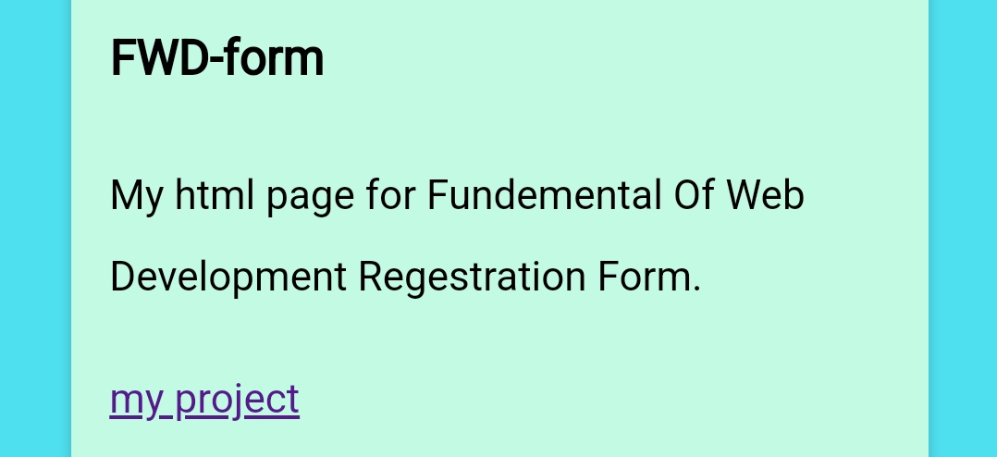

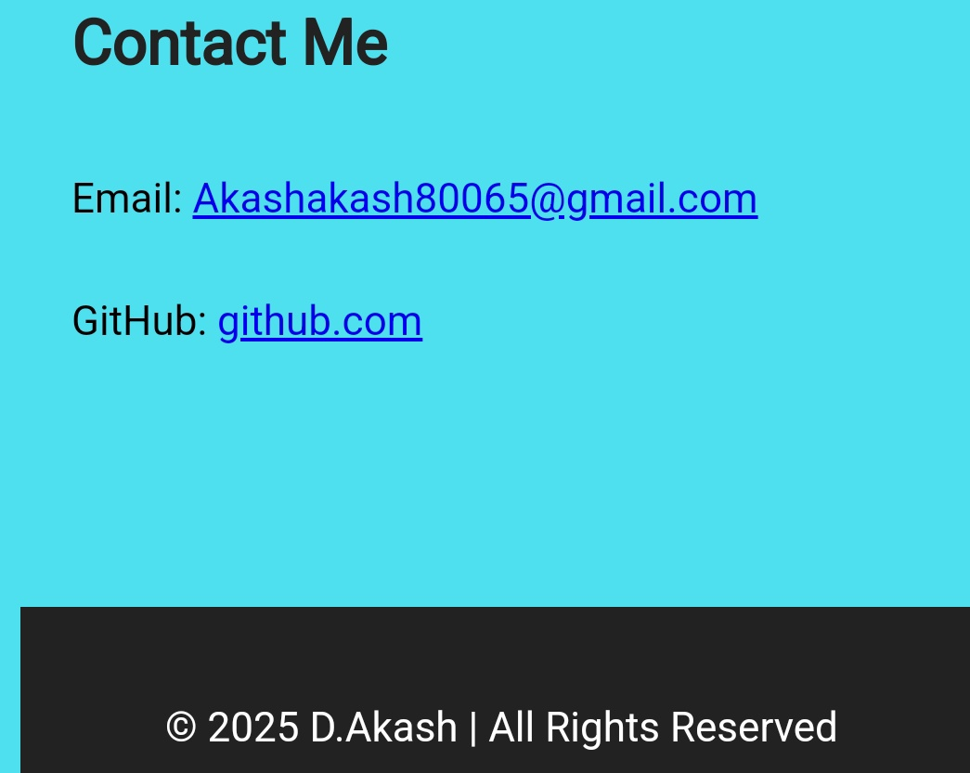

Slide 12
CONCLUSION
Final thoughts, learning outcomes, and project impact. Future scope (what can be improved/added later). *: This system reduces manual errors in attendance and can be expanded with cloud integration for large institutions.
12

Slide 13
GITHU B LINK
FOR MORE CONTEXT ME ON GITHU B
https://github.com/akashakash80065-byte

